Slide 1
E-MEDICARE
RLL PROJECT
GROUP - 08

Slide 2
TABLE OF CONTENT
Introduction
Flow Chart
Technologies Used
Modules
Outputs
Conclusion

Slide 3
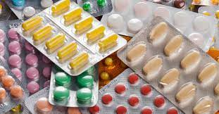
INTRODUCTION
The Digital Healthcare Revolution: In the age of digital transformation, healthcare services are undergoing a significant shift towards online platforms.
The E-Medicare System emerges as a prime example of this revolution, offering an intuitive web application that caters to the modern-day healthcare needs of individuals seeking convenient access to medicines.
The intuitive navigation, search functionalities, and detailed product descriptions ensure that users of all technical backgrounds can easily navigate the platform and find the medications they need.

Slide 4
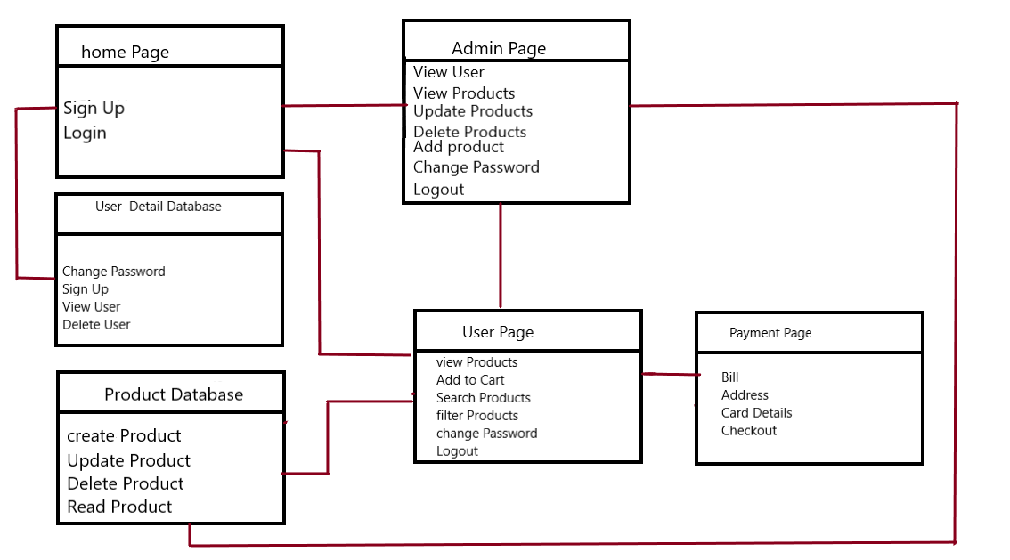
DATA FLOW

Slide 5

TECHNOLOGY USED
HTML
CSS
Server
Backend
MySql
Typescript
Angular CLI
JUnit

Slide 6
MODULES USED
ADMIN
USER
Login
Admin Dashboard
Add Product
Update Product
Delete Product
View Product
View User
Delete User
Change Password
Register
Login
User Dashboard
Change Password
Filters
Add To Cart
Checkout
Billing and Payment

Slide 7
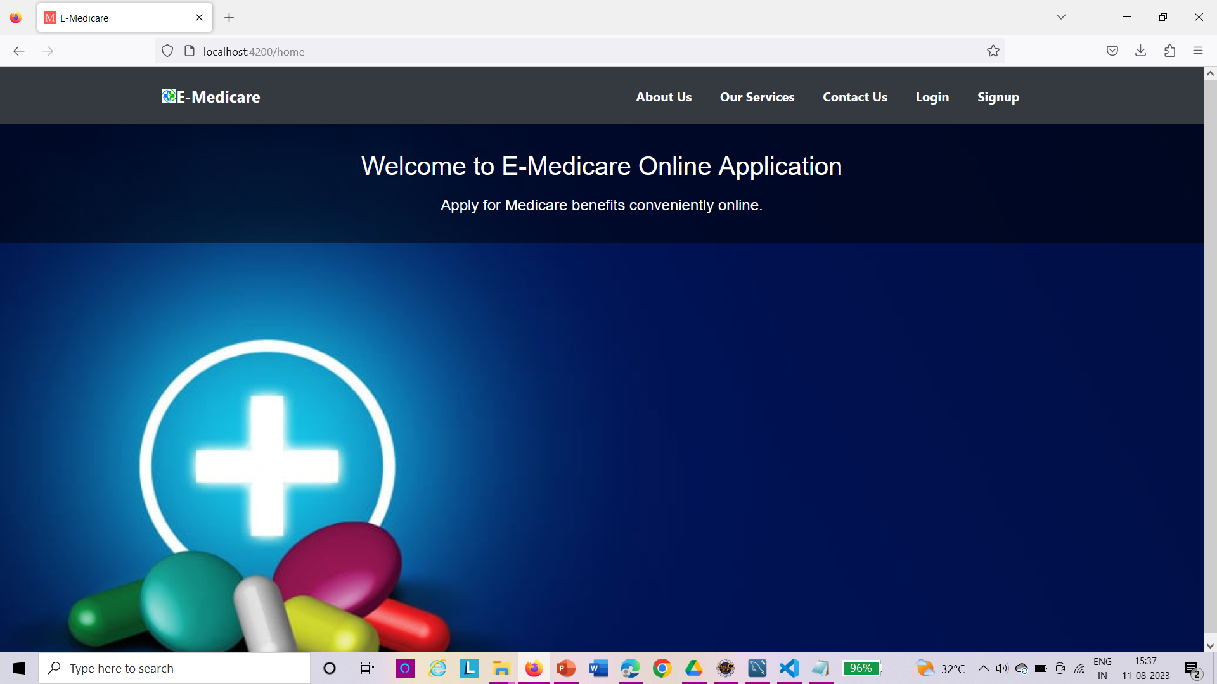
HOME PAGE

Slide 8
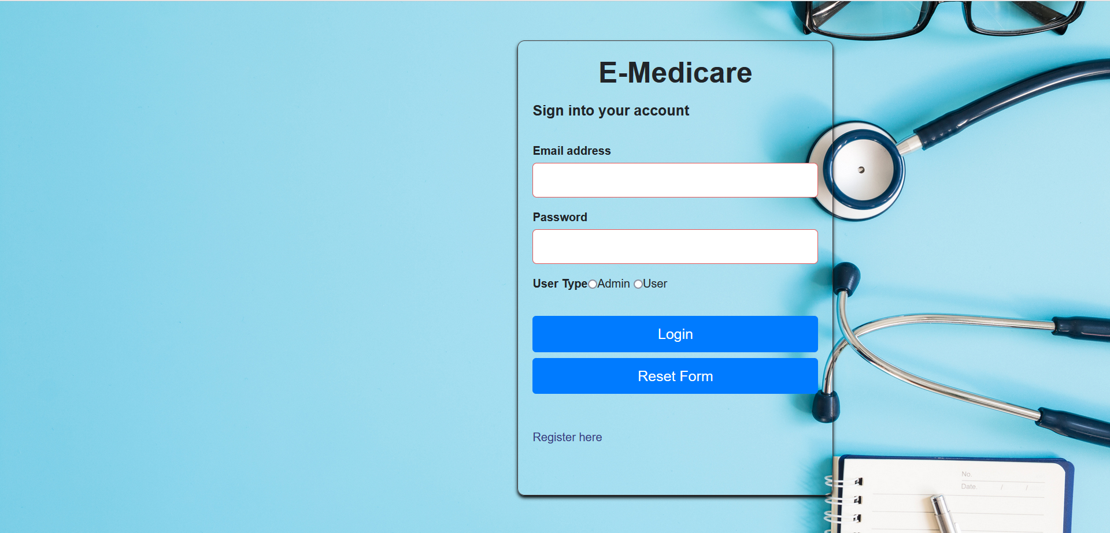
LOGIN PAGE

Slide 9
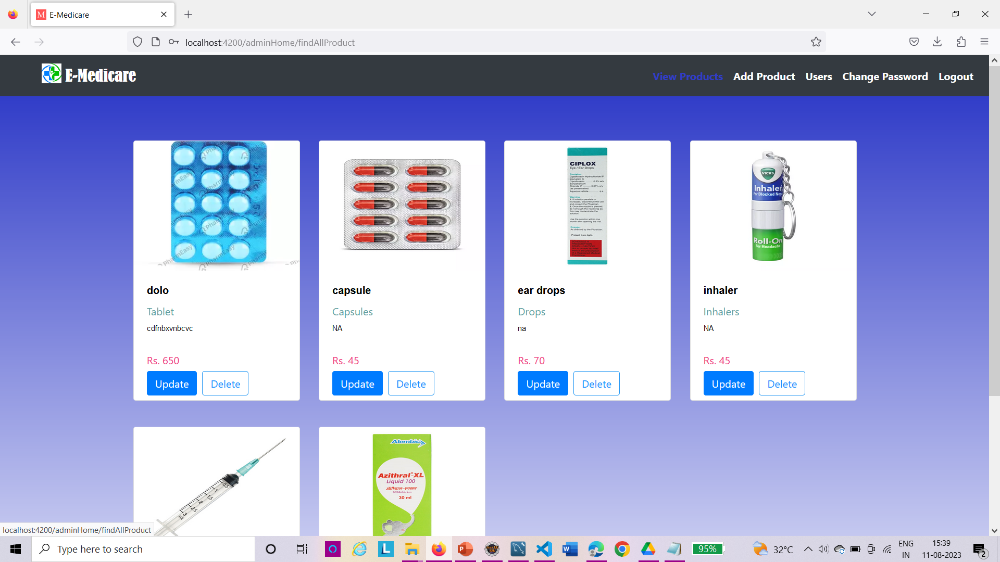
ADMIN PAGE

Slide 10
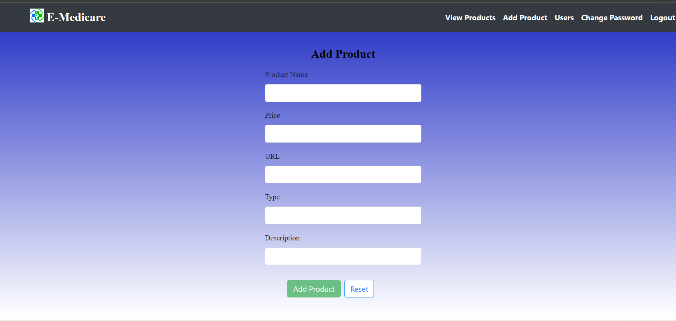
ADD PRODUCTS

Slide 11
VIEW PRODUCTS

Slide 12
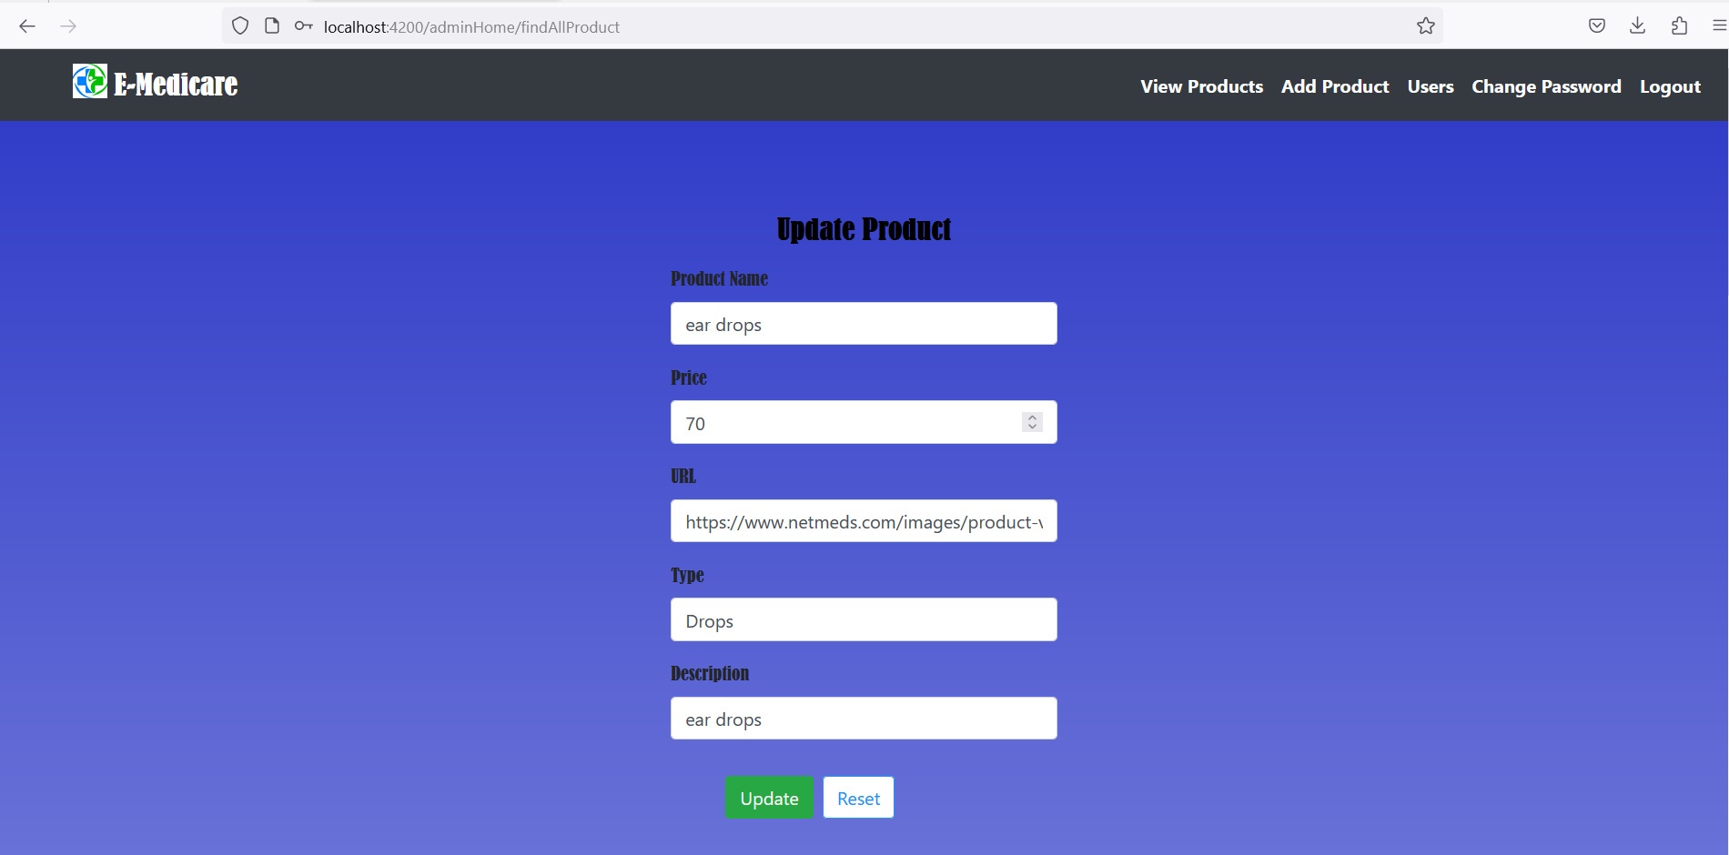
UPDATE PRODUCT

Slide 13
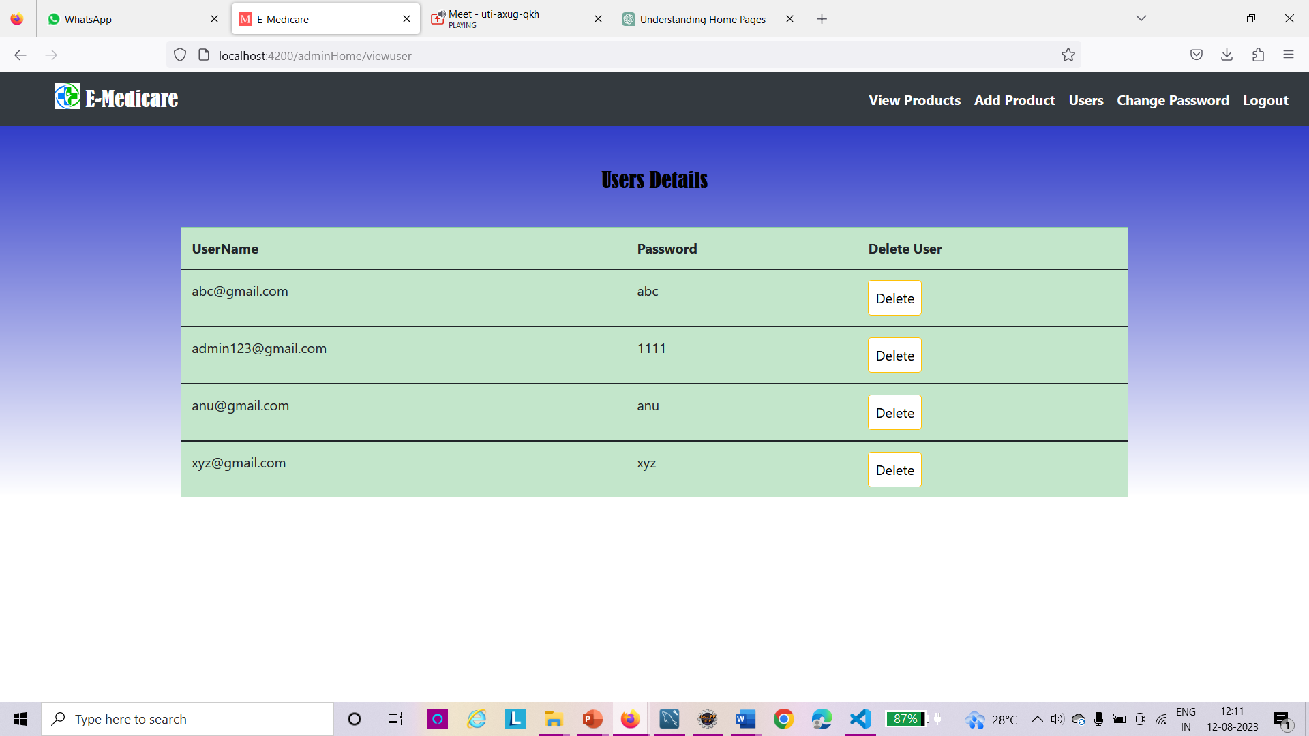
USER DETAILS & CHANGE PASSWORD

Slide 14
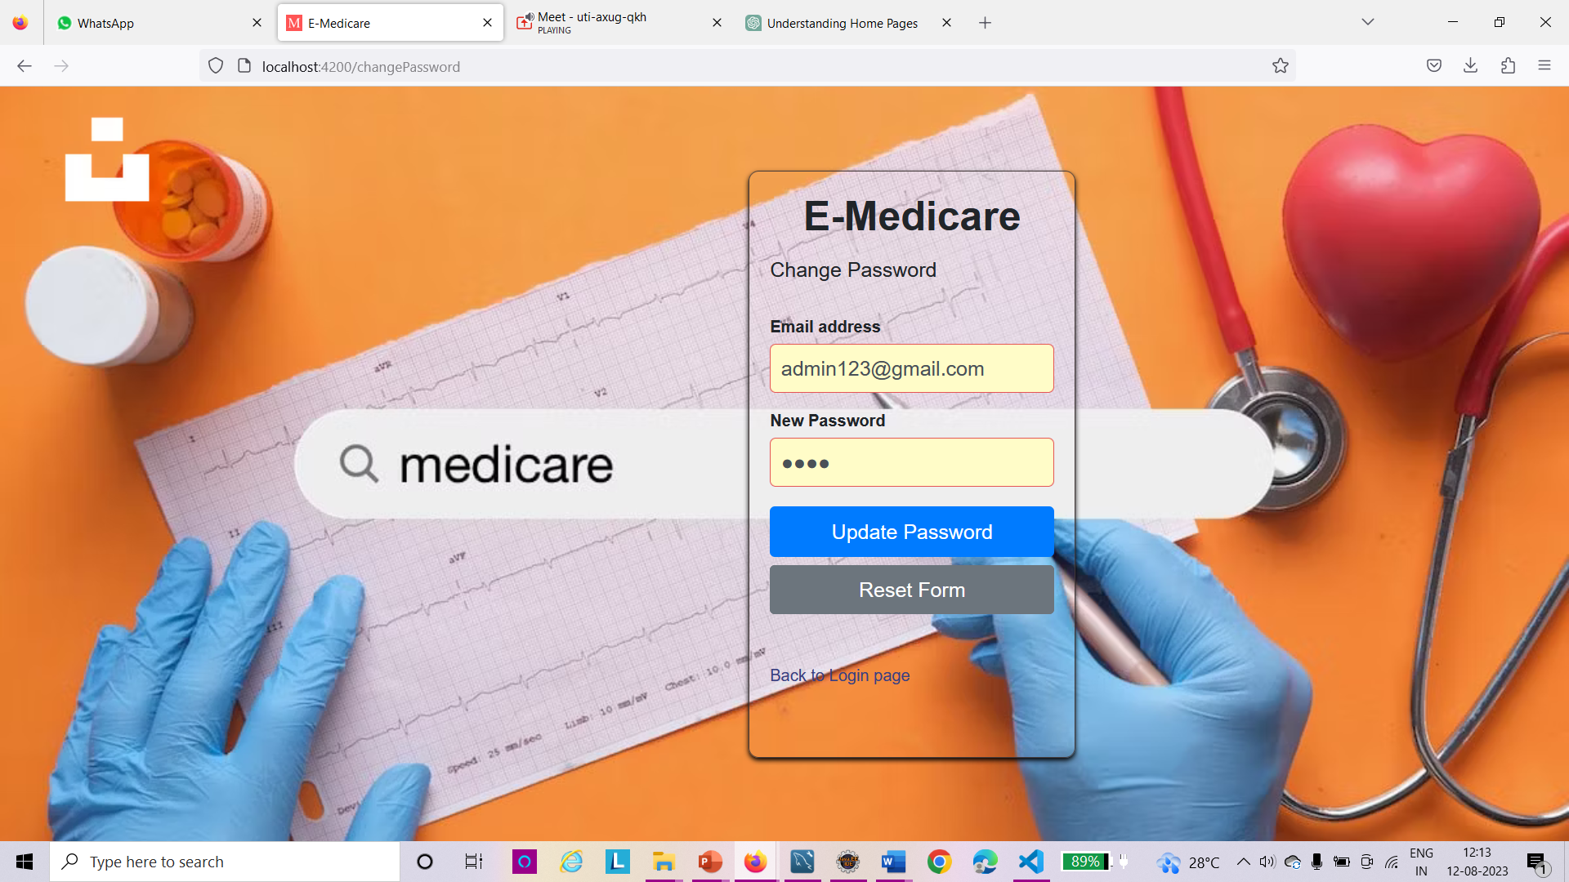

Slide 15
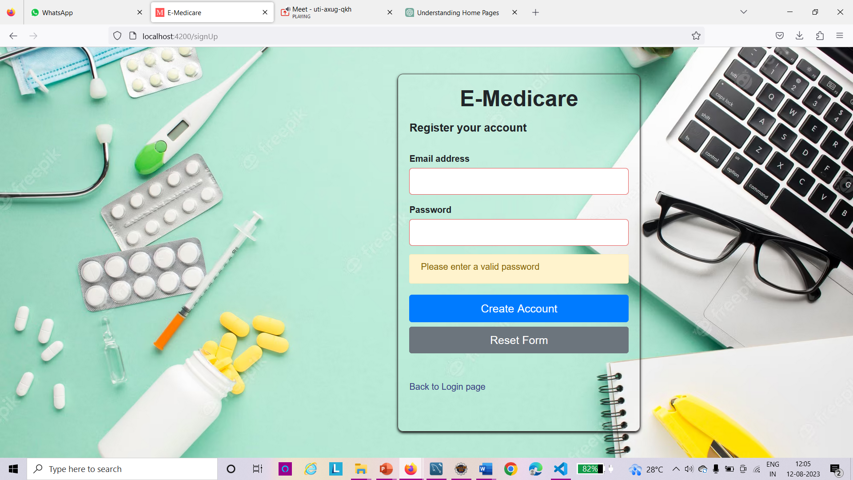
REGISTRATION PAGE

Slide 16
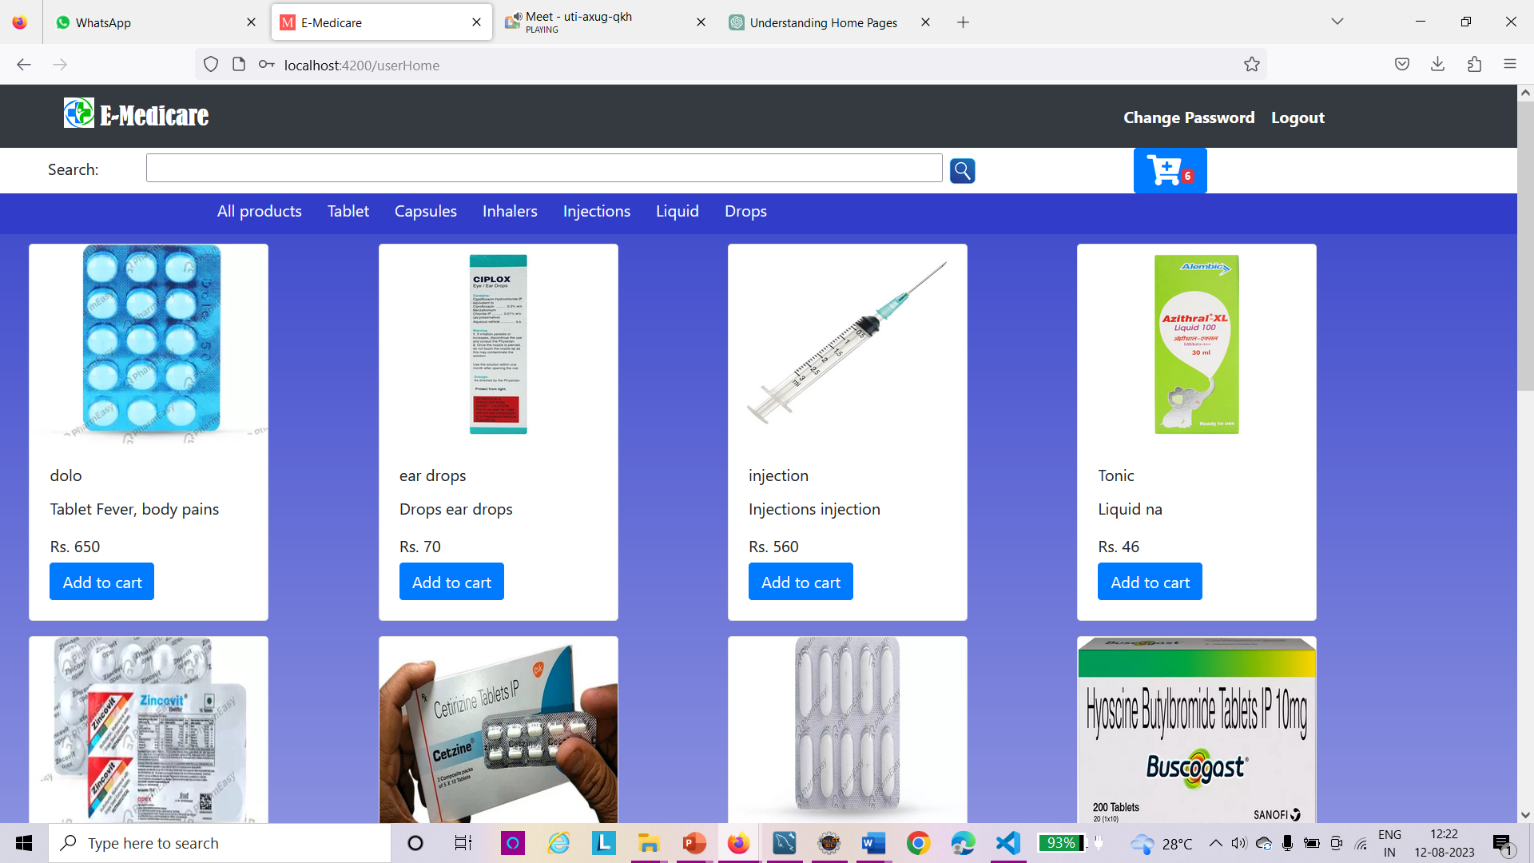
USER PAGE

Slide 17
USER DASHBOARD & FILTER

Slide 18
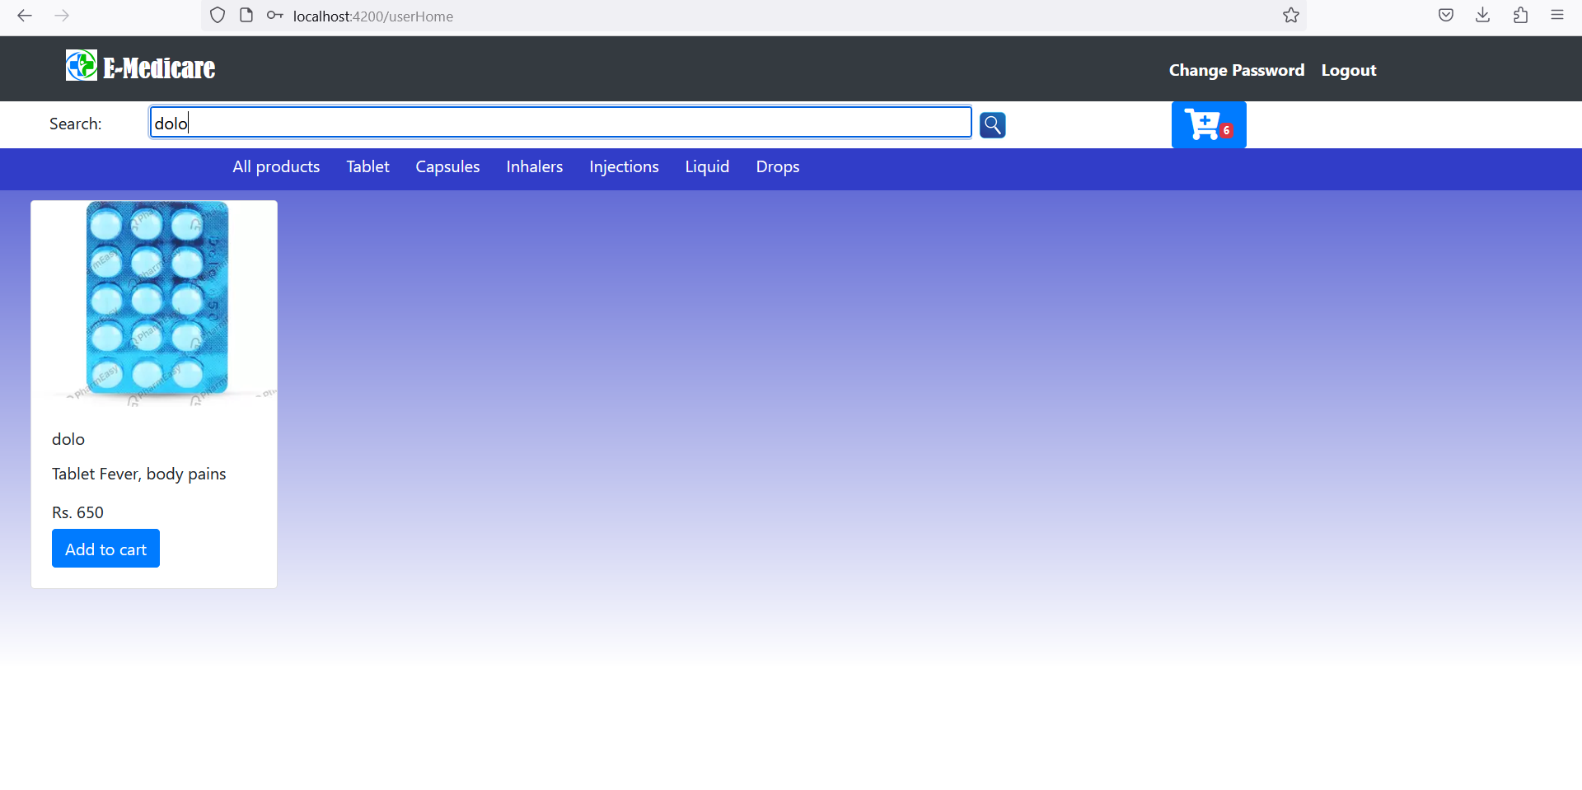
SEARCH PRODUCT

Slide 19
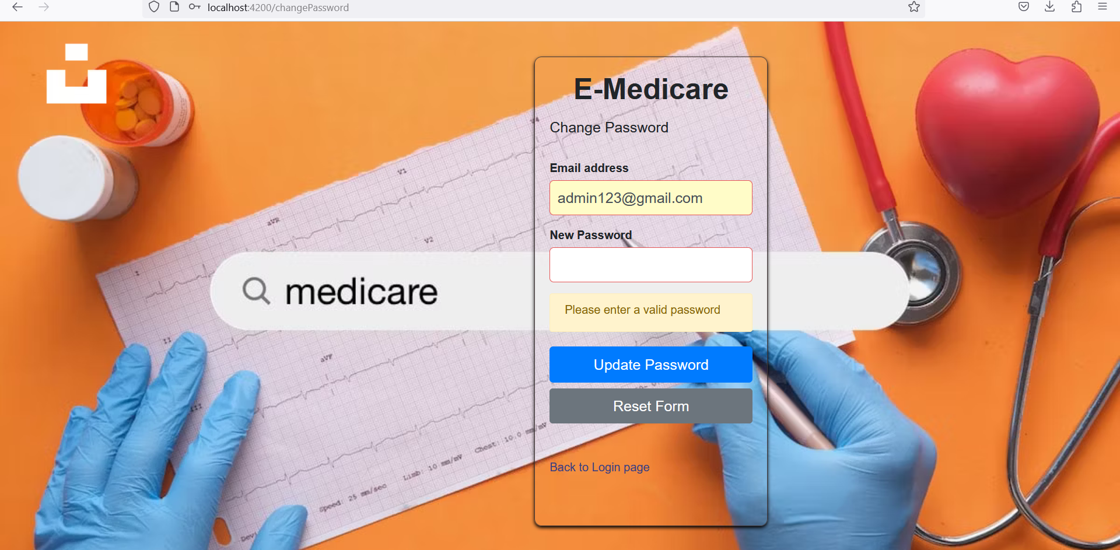
CHANGE PASSWORD

Slide 20
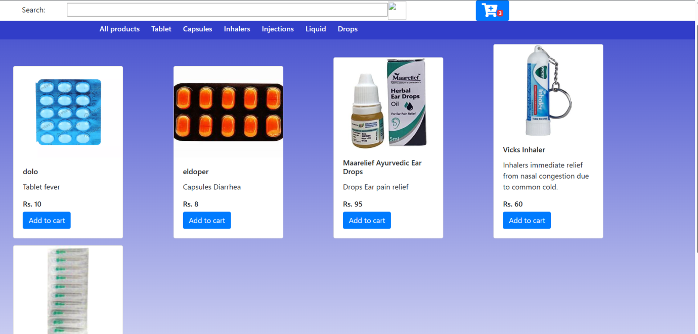
ADD TO CART

Slide 21
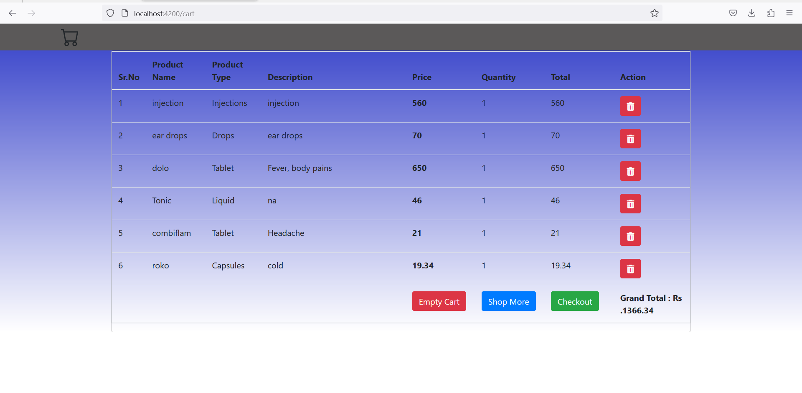

Slide 22
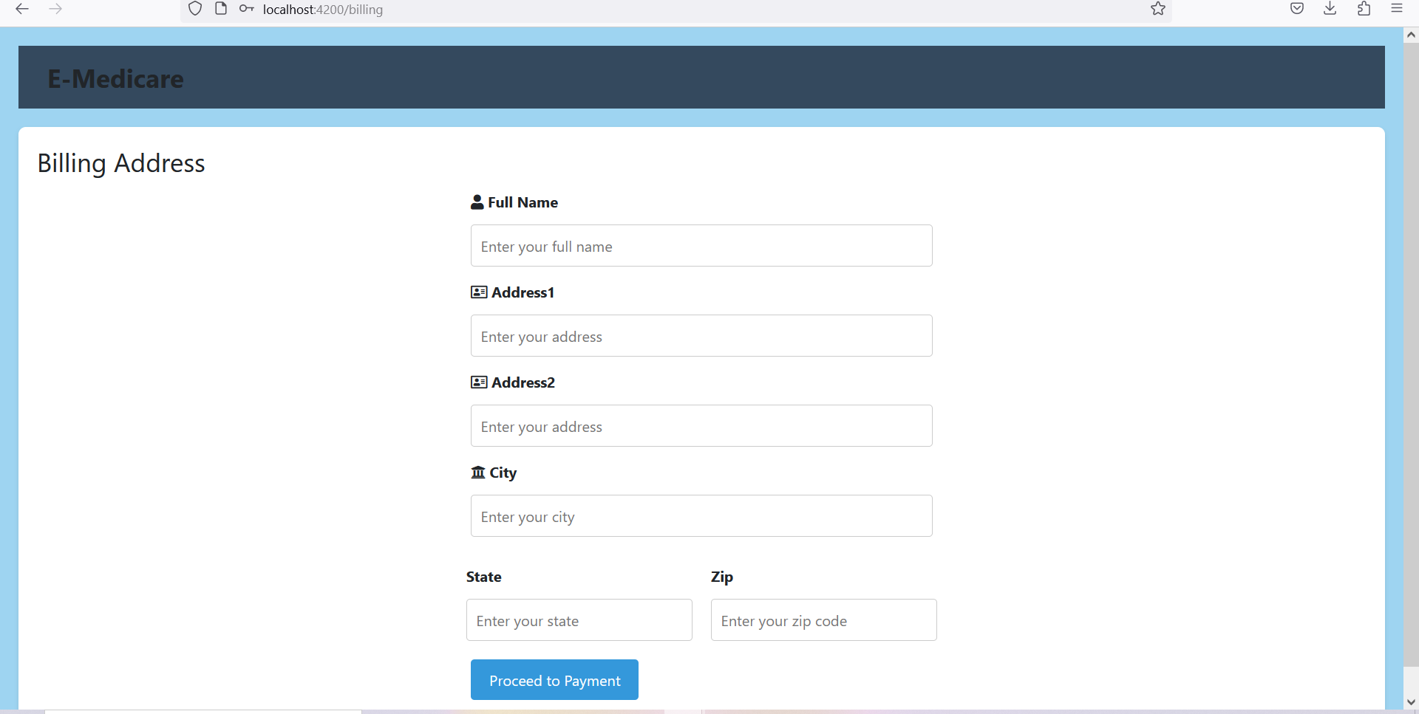
BILLING

Slide 23
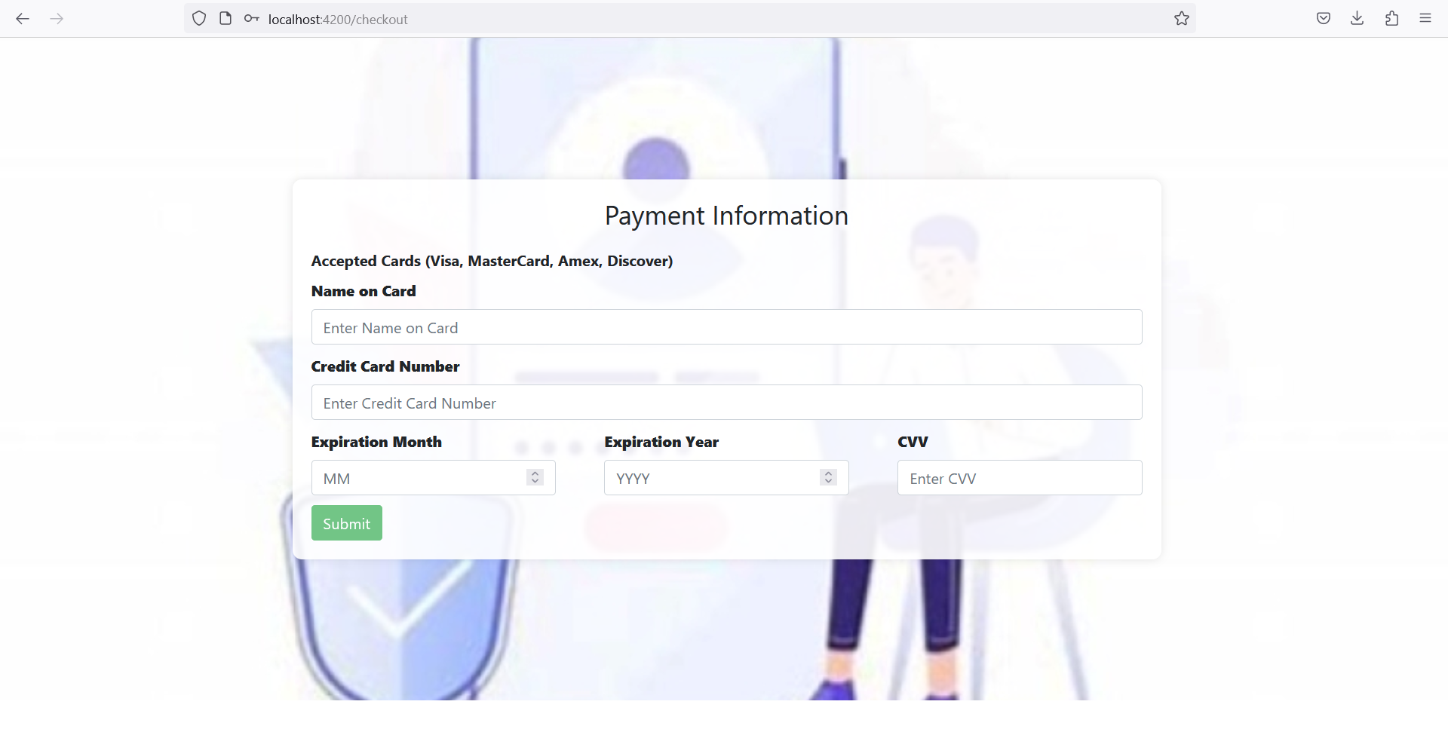
PAYMENT PAGE

Slide 24
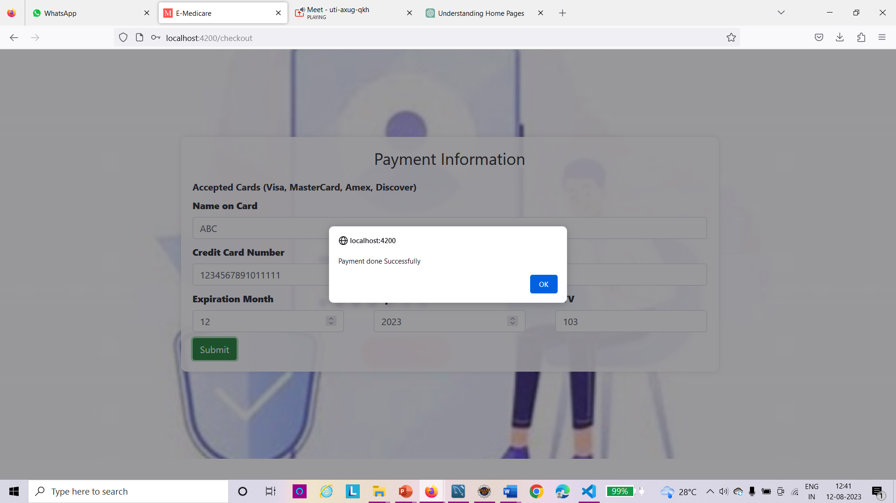

Slide 25
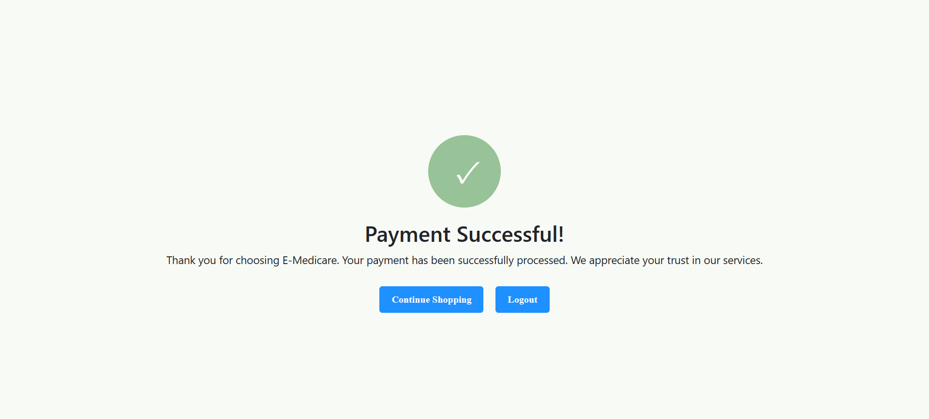

Slide 26
TESTING
Postman is the go-to tool for API testing and validation, while JUnit enables developers to develop highly reliable and bug-free code.

Slide 27
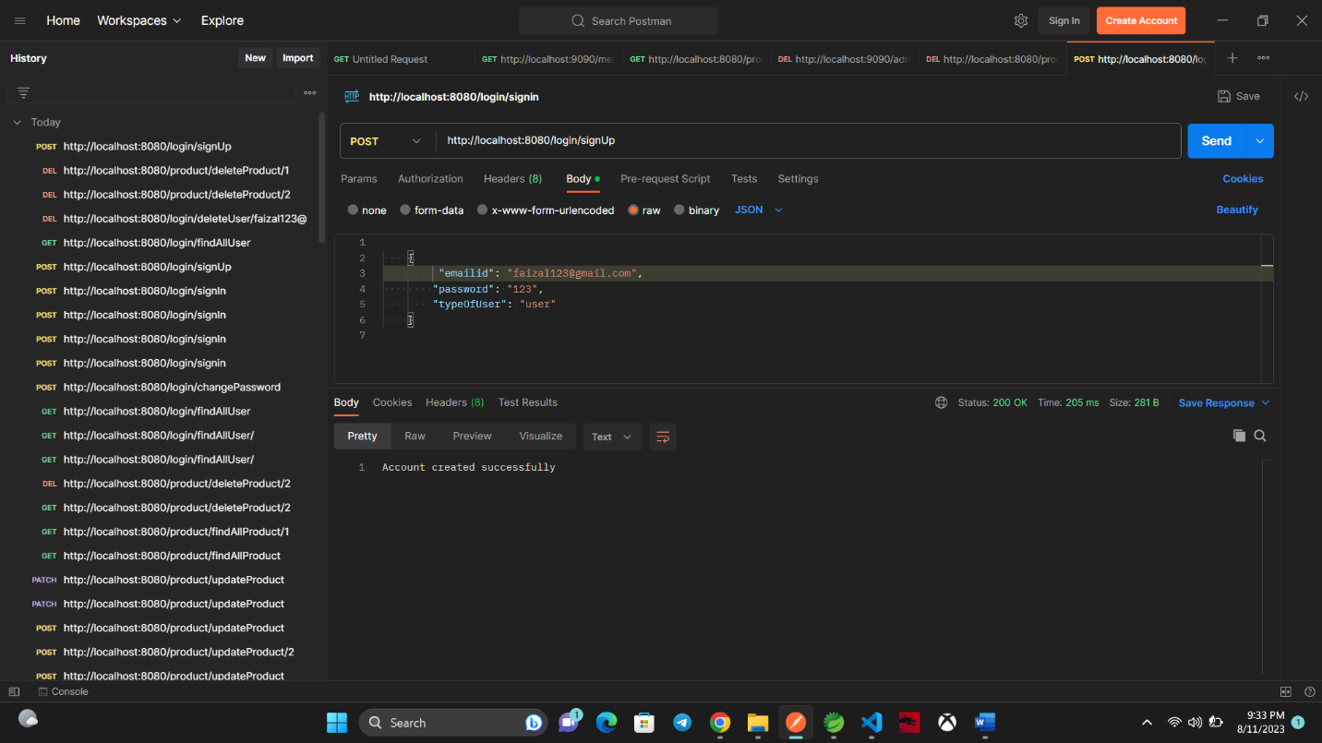

Slide 28
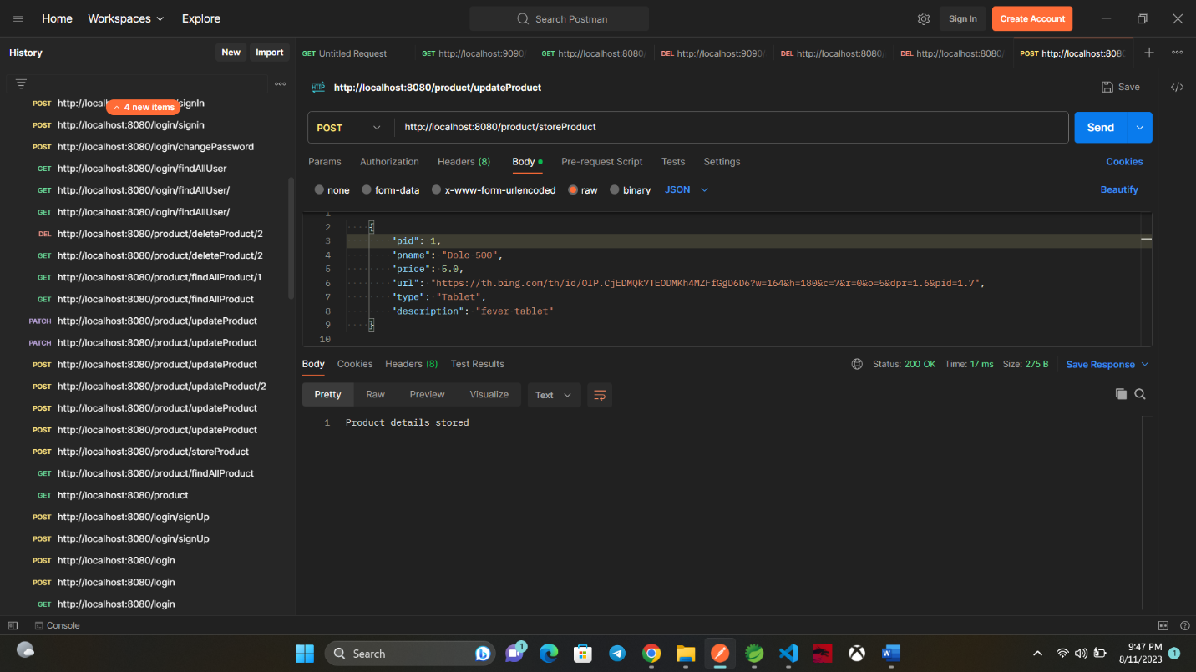

Slide 29
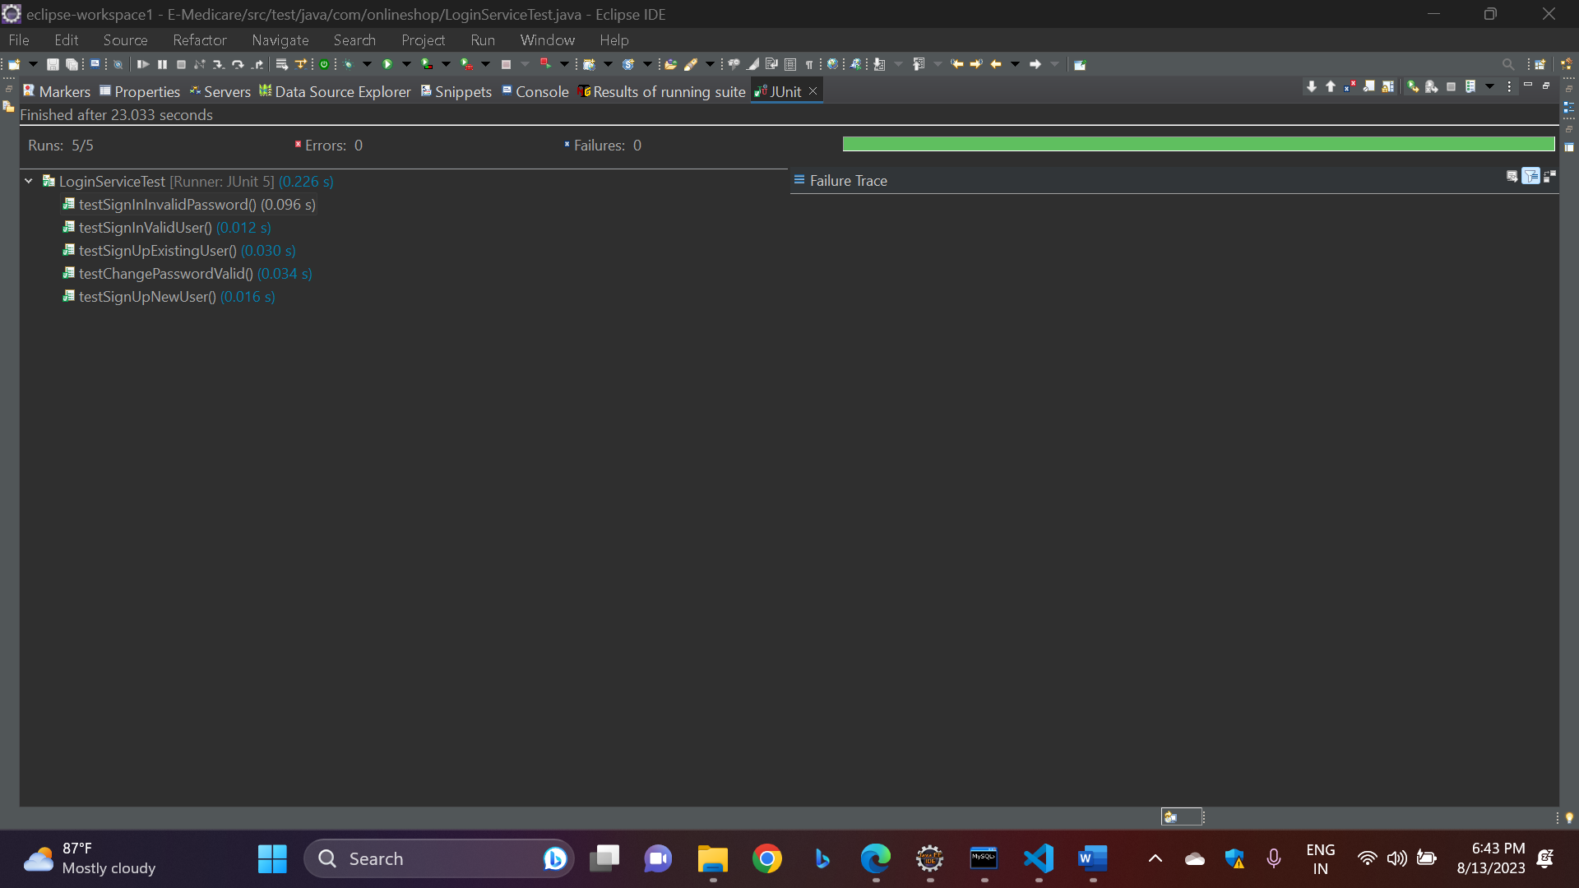

Slide 31
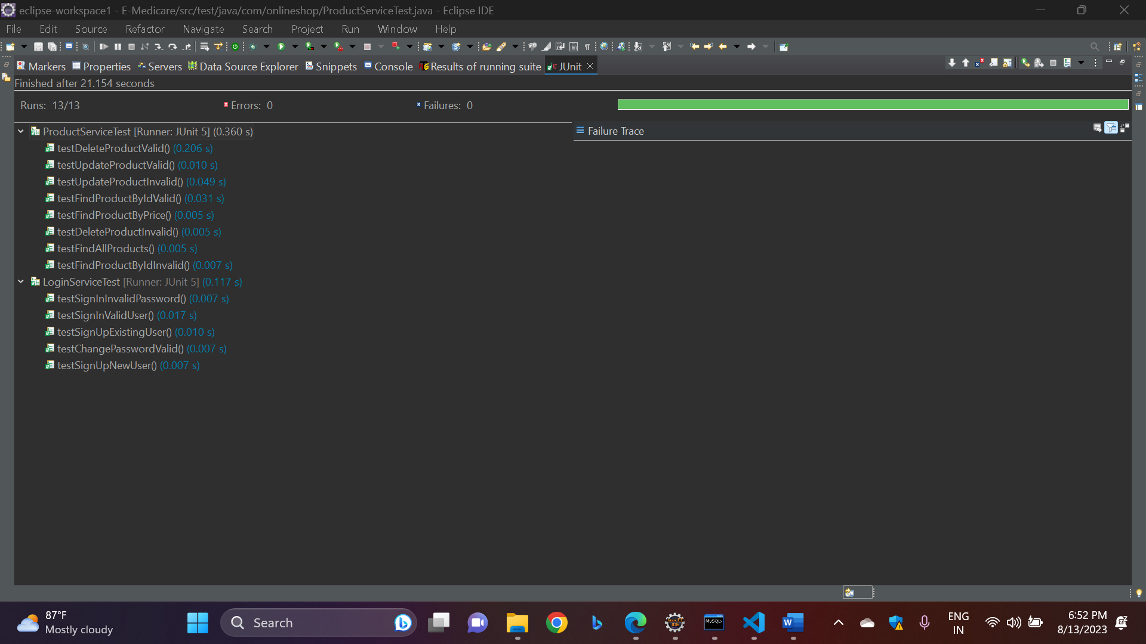

Slide 32
CONCLUSION
Our project is only a humble venture to satisfy the needs to manage their project work. Several user-friendly coding has also adopted.
The objective of software planning is to provide a frame work that enables the manger to make reasonable estimates made within a limited time frame at the beginning of the software project and should be updated regularly as the project progresses.
We understand the problem domain and produce a model of the system, which describes operations that can be performed on the system.
We included features and operations in detail, including screen layouts.
We designed user interface and security issues related to system.
Finally, the system is implemented and tested according to test cases.

Slide 33


